Slide 1






2024 Google Workspace Hackathon Pitch Deck
01.
Problem Statement
Leveraging AI for personalized customer interaction
02.
Presented by : The Code Queens
We Offer Solutions
AI-driven customer feedback collection and analysis tool using Apps Script integrated with Google Forms, Google Sheets, and Gmail.

Slide 2



Our Team
Xin Yi
Jean Lee
Lughano Mwalilino
Habibah Johan

Slide 3

Problem 1
Small businesses struggle with efficiently collecting and analyzing customer feedback.
Problem
Problem 2
Limited user-friendly options for integrating AI into customer interaction workflows.
List 3-5 problems your company observes and wants to solve.
Problem 3
Need for automated follow-up actions based on feedback sentiment, as manual processes are inefficient

Slide 4
Solution
List 3-5 ways your company proposes to solve them.
Solution 1
Solution 2
Solution 3
An integrated feedback collection and analysis tool using Google Forms, Sheets, Apps Script, and Notion API.
Automates feedback collection, sentiment analysis, and follow-up actions.
Provides actionable insights to improve customer satisfaction and business processes.

Slide 5




Key Features
Introduce your company's product or service as the ultimate solution to these problems.

Slide 6
1
2
Data Aggregation
Sentiment Analysis
Collect responses in Google Sheets and categorize by sentiment.
Use AI to analyze feedback and categorize it as positive, neutral, or negative.
3
Reporting and Visualization
4
Follow-up Actions
Generate summary reports and visualizations in Google Sheets.
Trigger automated emails based on sentiment analysis results.

Slide 7
1
Real-Time Sentiment Analysis
Automatically categorizes feedback based on sentiment as it is received, providing instant insights into customer satisfaction levels.
2
Intuitive AI Integration
Offers an easy-to-use platform that integrates AI-driven sentiment analysis without requiring technical expertise, making advanced AI accessible to all users.
3
Notion Integration
Store feedback data in Notion for centralized management.

Slide 8


Automated Feedback Collection
Integrates with existing Google Form.
Automatically sends feedback requests after each transaction through email or SMS.
Use Case
Follow-Up Actions
Example Business:
Type: Local Café
Location : neighborhood
Size: 10 employees
Customers: Local residents and office workers
Automatically sends personalized thank-you emails for positive feedback.
Sends apology and compensation offers for negative feedback.
Provides neutral feedback with additional queries to gather more insights.

Slide 9
Feasibility
Solves the issue of manual feedback collection.
Provides actionable insights to improve customer experience.
Enhances customer engagement through timely follow-ups.
Solution 1
Solution 2
Solution 3
Product scalability and integration with various platforms.
Cost-effectiveness for small businesses.
Potential for business growth and increased customer satisfaction.

Slide 10

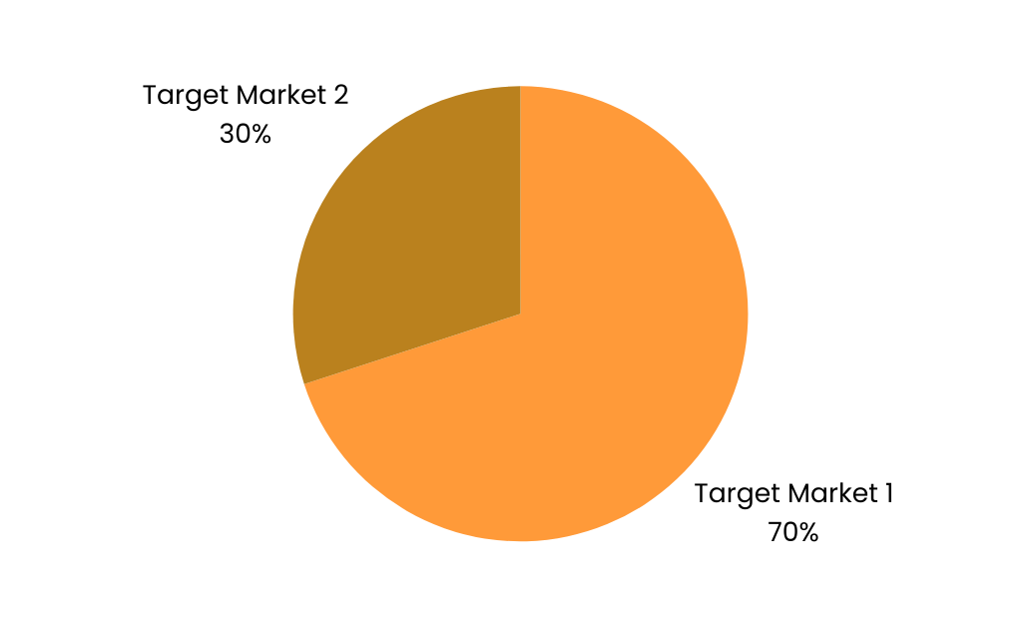
Target Market
Total Addressable Market (TAM)
All small businesses globally
Serviceable Available Market (SAM)
Small businesses in KL
Serviceable Obtainable Market (SOM)
Small businesses ready to adopt technology solutions.

Slide 11
20
23
Explain the marketing strategy that you propose to sell this product or service. Visualize the profile of your future customer and describe your strategy on how to reach them. This is an important step to convince the investors to trust your product proposal and invest in your company.
Competitor Analysis
@reallygreatsite

Slide 12


Future Enhancements
Forms
Feedback
Integration with other Google Workspace tools (e.g., Google Slides for presentation reports).
Advanced AI models for more accurate sentiment analysis.
Customizable feedback forms and reports.
Multi-language support for global reach.
Sheets
Collection
Gmail
Emails

